Slide 1
Predator-Prey Simulation Using Boids Model

Slide 2
General overview
Evolution
Survival probability
Using nature as design inspiration
Real world applications

Slide 3
Starting goal
Develop a realistic simulation replicating natural patterns
Simulate different types of predator / prey models
Implement adaptive model configurations
Large scale simulation

Slide 4
Predator tactics
Attack towards the groups centroid
Attack nearest
Attack most peripheral
Attack at random

Slide 5
Prey escape maneuvers
Avoid direction
Avoid position
Turn gamma
Turn random
Turn time
Zig zag

Slide 6
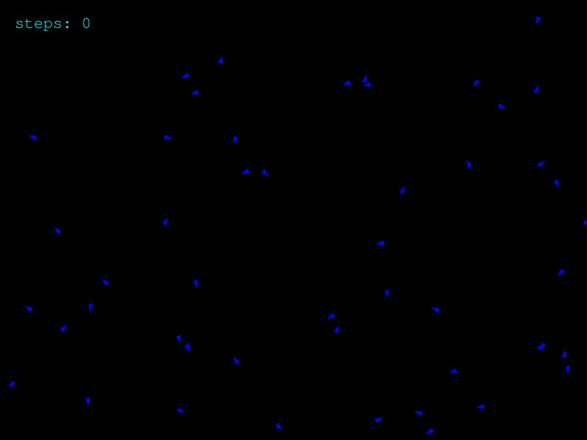
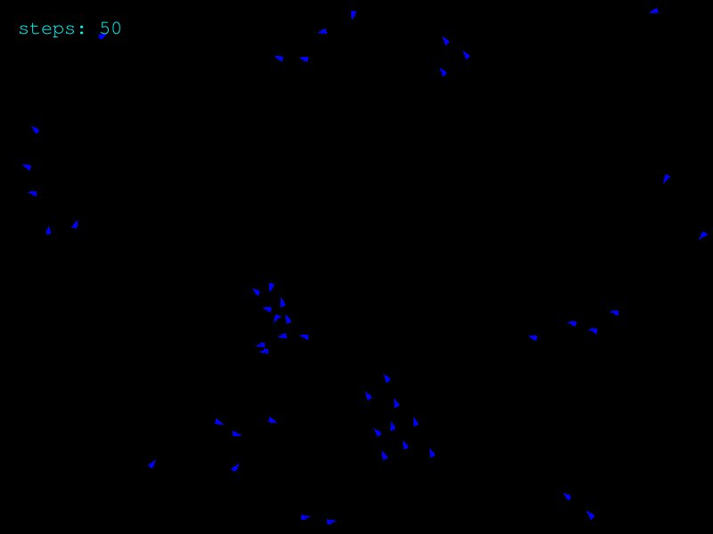
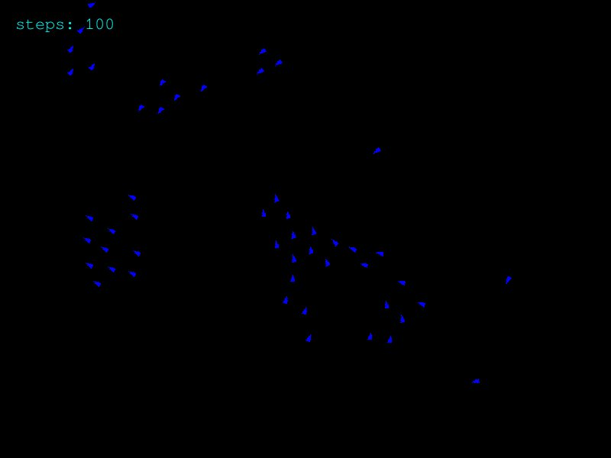
Basic boid model
Starting point
Step 50
Step 100

Slide 7
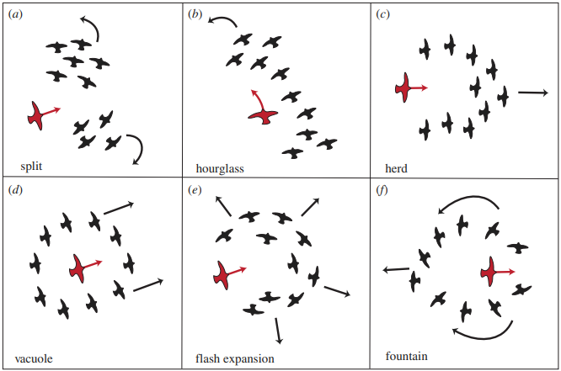
Introduction of a predator

Slide 8
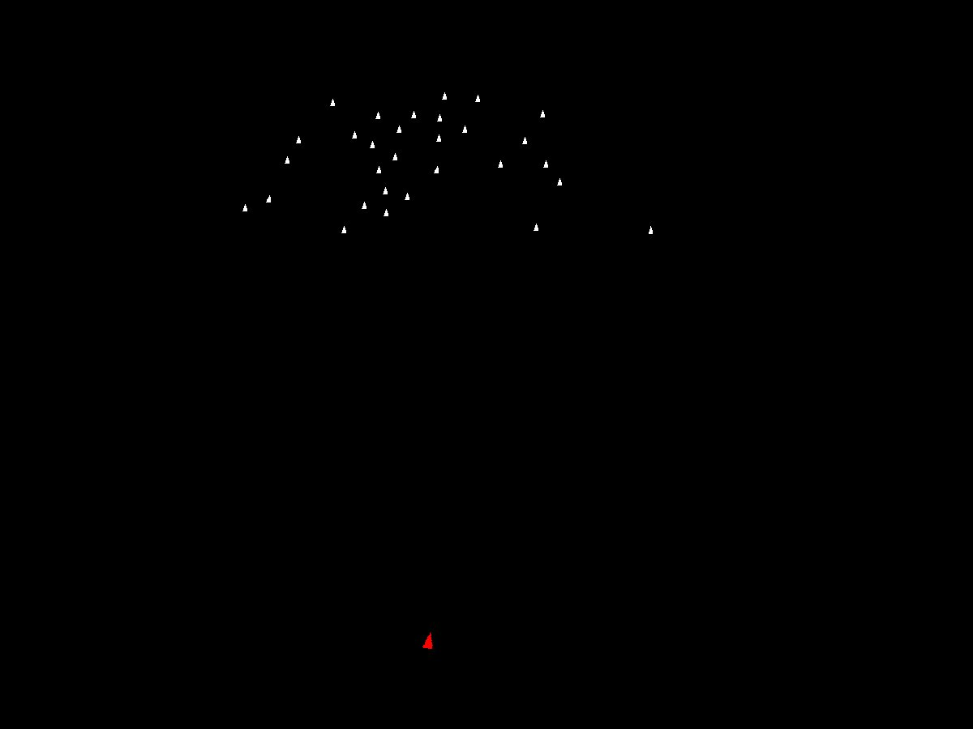
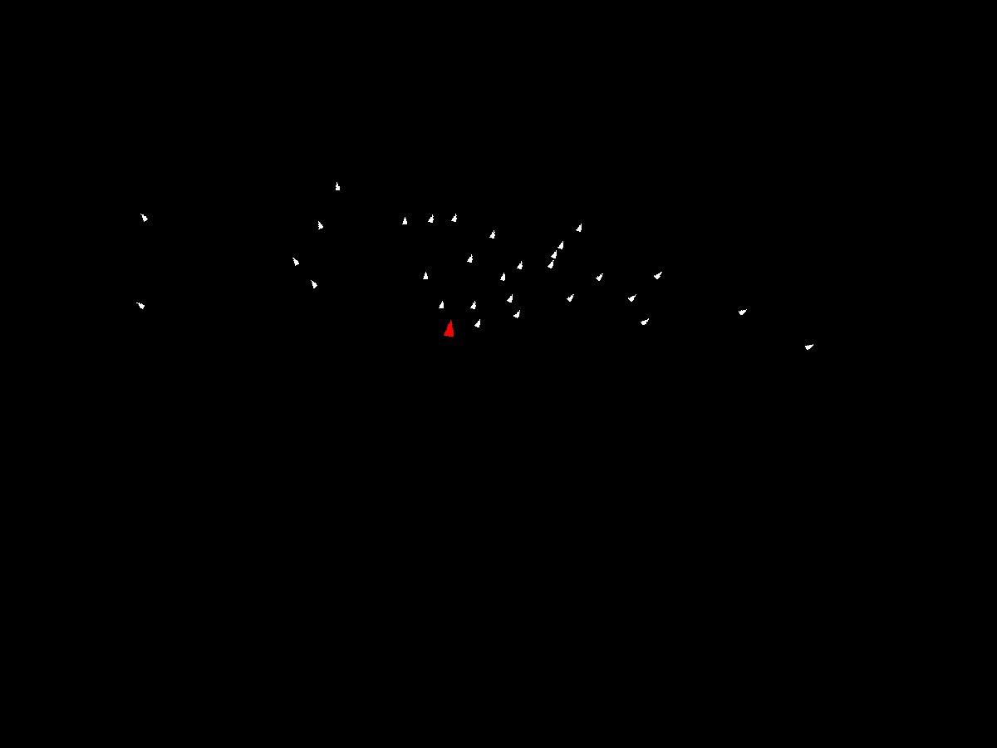
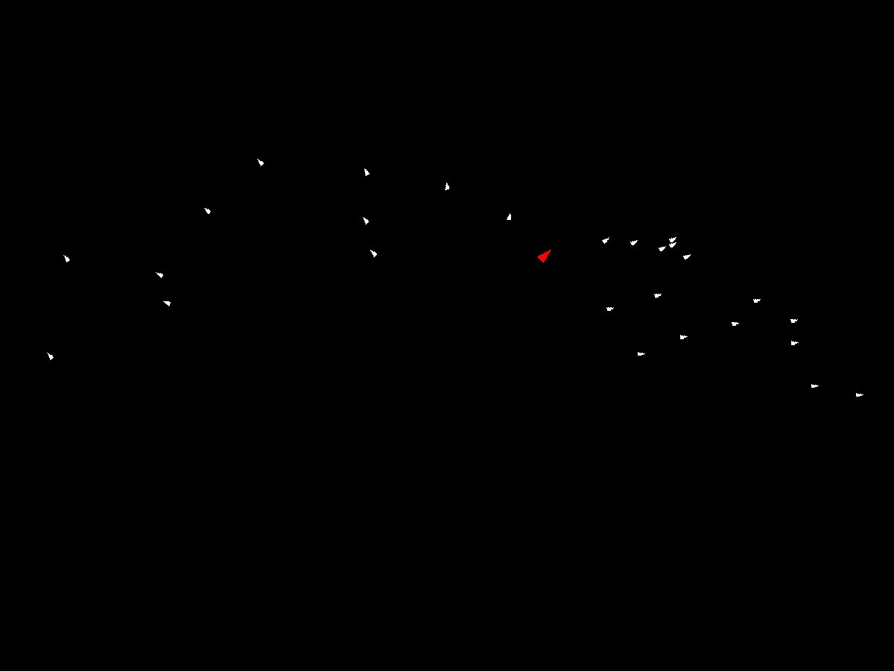
Generated patterns of collective escape
Split

Slide 9
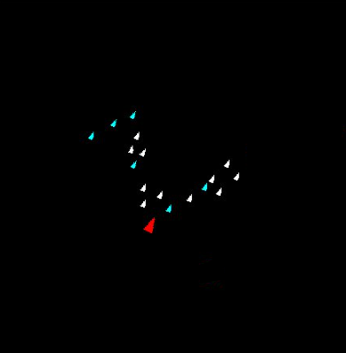
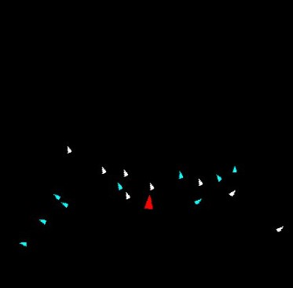
Generated patterns of collective escape
Herd
Flash expansion

Slide 10
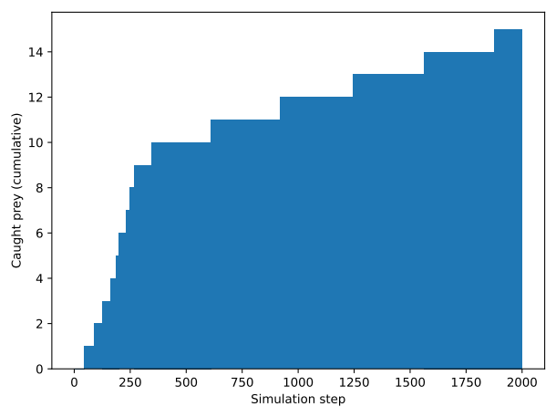
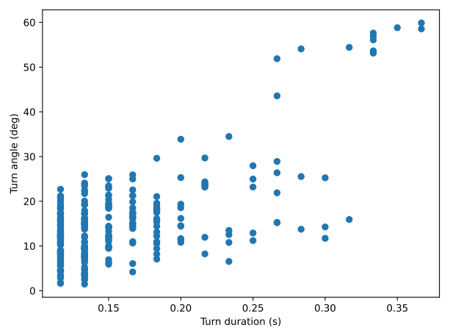
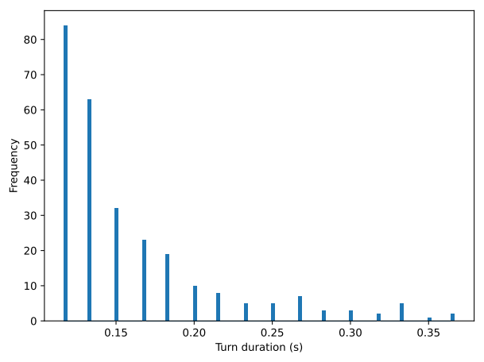
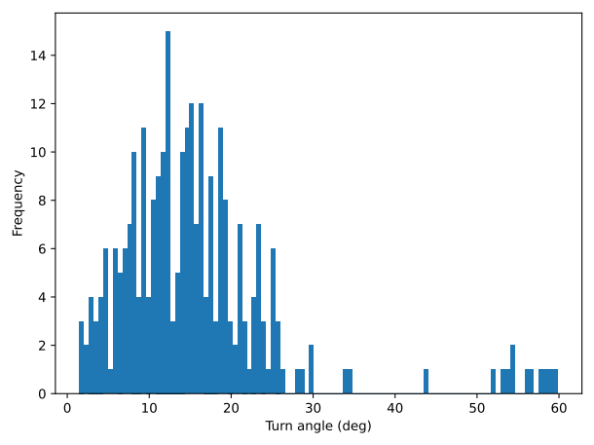
Attack nearest and avoid direction

Slide 11
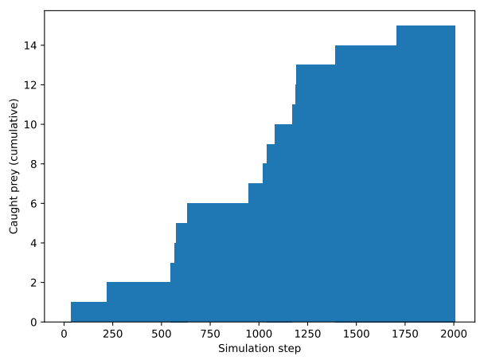
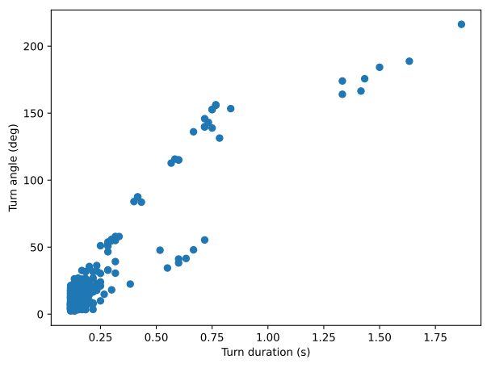
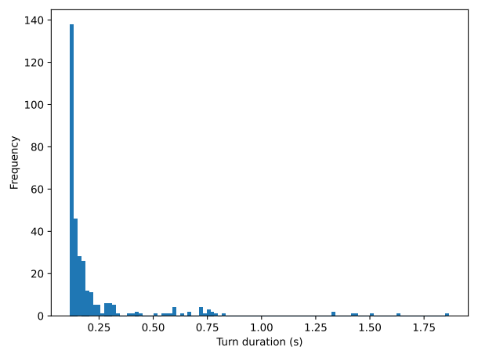
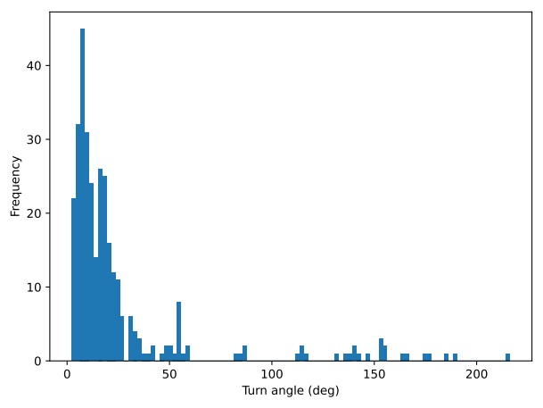
Attack most peripheral and avoid direction

Slide 12
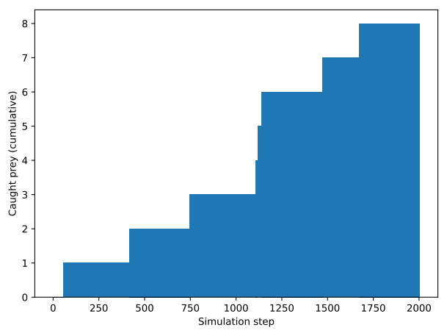
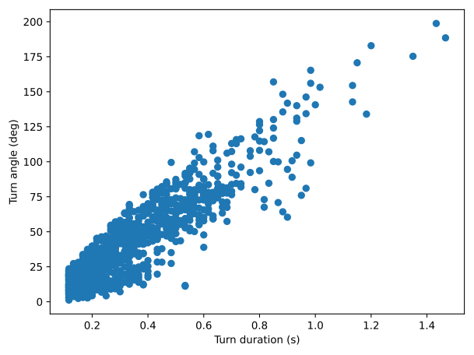
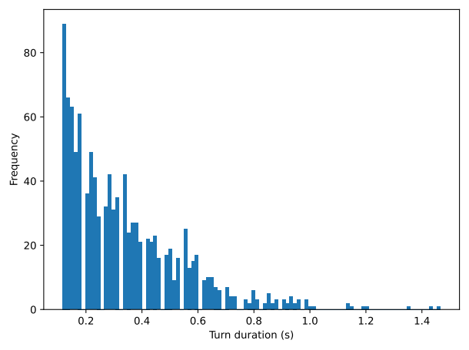
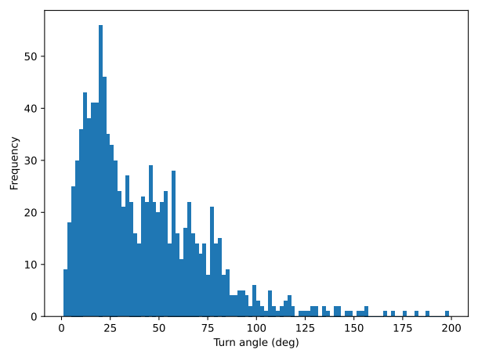
Attack nearest and avoid position

Slide 13
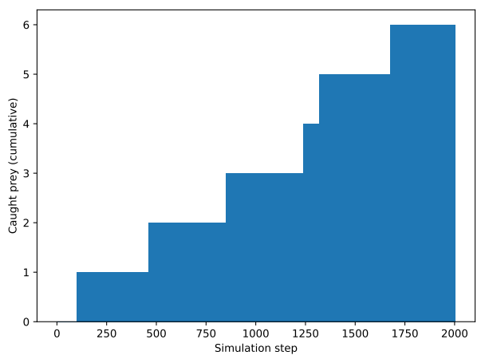
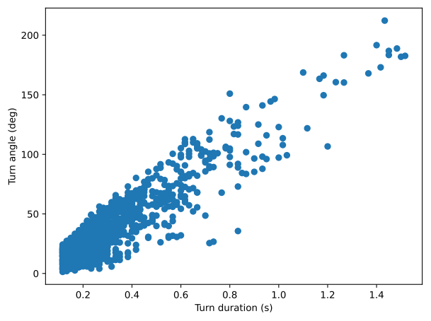
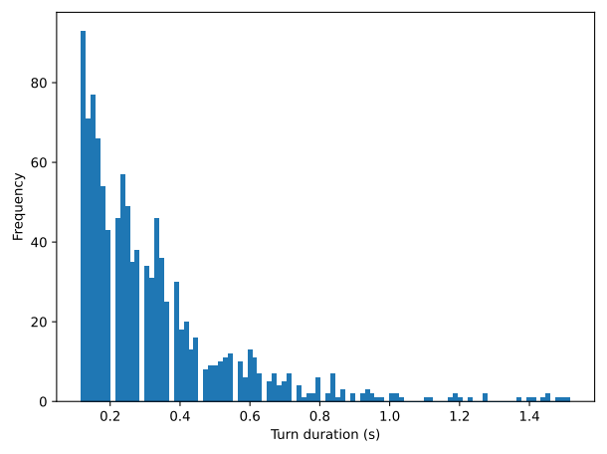
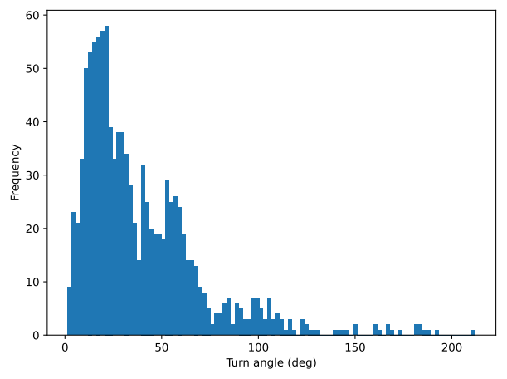
Attack most peripheral and avoid position

Slide 14
Biggest challenges
Scalable codebase (boids, behaviours)
Debuging
Toroidal coordinates
Predator vision

Slide 15
Starting from scratch
Simulation parameterization

