Slide 1
Benchmarking
Based on
- I-BiDaaS project: https://www.ibidaas.eu/consortium
- BigDataBench 5.0: http://www.benchcouncil.org/BigDataBench/index.html#Handbook

Slide 12
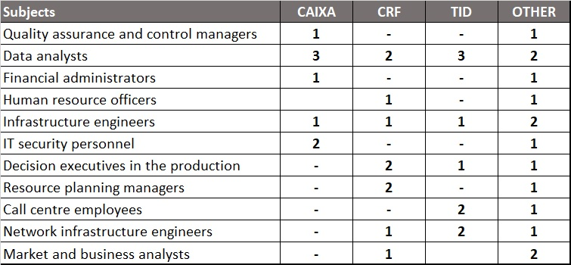

Slide 13
